Slide 1
Lab Week - 1
Writing basic SQL statements

Slide 2
Writing basic SQL statements
In this session:
  Objectives of SQL
  Capabilities of SQL SELECT statements
  Writing SQL statements
  Execution of a basic SELECT statement
  Arithmetic Operator precedence
  Nulls and Aliases
  Concatenation
  Literal strings
  Limiting outputs
Notes:
Lesson Aim
To extract data from the database, you need to use the structured query language (SQL) SELECT statement. You may need to restrict the columns that are displayed. This lesson describes all the SQL statements that you need to perform these actions.
You may want to create SELECT statements that can be used time and time again. This lesson also covers the use of SQL*Plus commands to execute SQL statements.

Slide 3
Objectives of SQL
Ideally, database language should allow user to:
  create the database and relation structures;
  perform insertion, modification, deletion of data from relations;
  perform simple and complex queries.
Must perform these tasks with minimal user effort and command structure/syntax must be easy to learn.
It must be portable.

Slide 4
Objectives of SQL
SQL is relatively easy to learn:
  it is non-procedural - you specify what information you require, rather than how to get it;
  it is essentially free-format.

Slide 5
Capabilities of SQL SELECT Statements
Selection
Projection
Table 1
Table 1
Join
Table 1
Table 2
Notes:
Capabilities of SQL SELECT Statements
A SELECT statement retrieves information from the database. Using a SELECT statement, you can do the following:
Selection: You can use the selection capability in SQL to choose the rows in a table that you want returned by a query. You can use various criteria to selectively restrict the rows that you see.
Projection: You can use the projection capability in SQL to choose the columns in a table that you want returned by your query. You can choose as few or as many columns of the table as you require.
Join: You can use the join capability in SQL to bring together data that is stored in different tables by creating a link through a column that both the tables share. You will learn more about joins in a later lesson.

Slide 6
Basic SELECT Statement
SELECT identifies what columns.
FROM identifies which table.
SELECT [DISTINCT] {*, column [alias],...}
FROM table;

Slide 7
Writing SQL Statements
SQL statement consists of reserved words and user-defined words.
Reserved words are a fixed part of SQL and must be spelt exactly as required and cannot be split across lines.
User-defined words are made up by user and represent names of various database objects such as relations, columns, views.

Slide 8
Writing SQL Statements
Most components of an SQL statement are case insensitive, except for literal character data.
More readable with indentation and lineation:
  Each clause should begin on a new line.
  Start of a clause should line up with start of other clauses.
  If clause has several parts, should each appear on a separate line and be indented under start of clause.

Slide 9

Selecting All Columns
SELECT *
FROM departments;
Notes:
Selecting All Columns, All Rows
You can display all columns of data in a table by following the SELECT keyword with an asterisk (*). In the example on the slide, the department table contains three columns: DEPTNO, DNAME, and LOC. The table contains four rows, one for each department.
You can also display all columns in the table by listing all the columns after the SELECT keyword. For example, the following SQL statement, like the example on the slide, displays all columns and all rows of the DEPT table:
SQL> SELECT deptno, dname, loc
2 FROM dept;

Slide 10

Selecting Specific Columns
SELECT department_id, location_id
FROM departments;
Notes:
Selecting Specific Columns, All Rows
You can use the SELECT statement to display specific columns of the table by specifying the column names, separated by commas. The example on the slide displays all the department numbers and locations from the DEPT table.
In the SELECT clause, specify the columns that you want to see, in the order in which you want them to appear in the output. For example, to display location before department number, you use the following statement:

Slide 11
Arithmetic Expressions
Create expressions on NUMBER and DATE data by using arithmetic operators.
Operator
+
-
*
/
Description
Add
Subtract
Multiply
Divide
Notes:
Arithmetic Expressions
You may need to modify the way in which data is displayed, perform calculations, or look at what-if scenarios. This is possible using arithmetic expressions. An arithmetic expression may contain column names, constant numeric values, and the arithmetic operators.
Arithmetic Operators
The slide lists the arithmetic operators available in SQL. You can use arithmetic operators in any clause of a SQL statement except the FROM clause.

Slide 12

Using Arithmetic Operators
SELECT last_name, salary, salary + 300
FROM employees;
…
Notes:
Using Arithmetic Operators
The example in the slide uses the addition operator to calculate a salary increase of $300 for all employees and displays a new SAL+300 column in the output.
Note that the resultant calculated column SAL+300 is not a new column in the EMP table; it is for display only. By default, the name of a new column comes from the calculation that generated it—in this case, sal+300.
Note: SQL*Plus ignores blank spaces before and after the arithmetic operator.

Slide 13
Operator Precedence
Multiplication and division take priority over addition and subtraction.
Operators of the same priority are evaluated from left to right.
Parentheses are used to force prioritised evaluation and to clarify statements.
_
*
/
+
Notes:
Operator Precedence
If an arithmetic expression contains more than one operator, multiplication and division are evaluated first. If operators within an expression are of same priority, then evaluation is done from left to right.
You can use parentheses to force the expression within parentheses to be evaluated first.

Slide 14


Operator Precedence
SELECT last_name, salary, 12*salary+100
FROM employees;
1
…
SELECT last_name, salary, 12*(salary+100)
FROM employees;
2
…
Notes:
Operator Precedence (continued)
The example on the slide displays the name, salary, and annual compensation of employees. It calculates the annual compensation as 12 multiplied by the monthly salary, plus a one-time bonus of $100. Notice that multiplication is performed before addition.
Note: Use parentheses to reinforce the standard order of precedence and to improve clarity. For example, the expression above can be written as (12*sal)+100 with no change in the result.

Slide 15
Defining a Null
  A null is a value that is unavailable, unassigned, unknown, or inapplicable.
  A null is not the same as a zero or a blank space.
SELECT last_name, job_id, salary, commission_pct
FROM employees;
…
…
Notes:
Null Values
If a row lacks the data value for a particular column, that value is said to be null, or to contain null.
A null value is a value that is unavailable, unassigned, unknown, or inapplicable. A null value is not the same as zero or a space. Zero is a number, and a space is a character.
Columns of any datatype can contain null values, unless the column was defined as NOT NULL or as PRIMARY KEY when the column was created.
In the COMM column in the EMP table, you notice that only a SALESMAN can earn commission. Other employees are not entitled to earn commission. A null value represents that fact. Turner, who is a salesman, does not earn any commission. Notice that his commission is zero and not null.

Slide 16
Nulls in Arithmetic Expressions
Arithmetic expressions containing a null value evaluate to null.
SELECT last_name, 12*salary*commission_pct
FROM employees;
…
…
Notes:
Null Values (continued)
If any column value in an arithmetic expression is null, the result is null. For example, if you attempt to perform division with zero, you get an error. However, if you divide a number by null, the result is a null or unknown.
In the example on the slide, employee KING is not in SALESMAN and does not get any commission. Because the COMM column in the arithmetic expression is null, the result is null.

Slide 17
Defining a Column Alias
Renames a column heading
Is useful with calculations
Immediately follows column name; optional AS keyword between column name and alias
Requires double quotation marks if it contains spaces or special characters or is case sensitive.
Notes:
Column Aliases
When displaying the result of a query, SQL*Plus normally uses the name of the selected column as the column heading. In many cases, this heading may not be descriptive and hence is difficult to understand. You can change a column heading by using a column alias.
Specify the alias after the column in the SELECT list using a space as a separator. By default, alias headings appear in uppercase. If the alias contains spaces, special characters (such as # or $), or is case sensitive, enclose the alias in double quotation marks (" ").
Note
Within a SQL statement, a column alias can be used in both the SELECT clause and the ORDER BY clause. You cannot use column aliases in the WHERE clause. Both alias features comply with the ANSI SQL 92 standard.

Slide 18


Using Column Aliases
SELECT last_name AS name, commission_pct comm
FROM employees;
…
SELECT last_name "Name" , salary*12 "Annual Salary"
FROM employees;
…
Notes:
Column Aliases (continued)
The first example displays the name and the monthly salary of all the employees. Notice that the optional AS keyword has been used before the column alias name. The result of the query would be the same whether the AS keyword is used or not. Also notice that the SQL statement has the column aliases, name and salary, in lowercase, whereas the result of the query displays the column headings in uppercase. As mentioned in the last slide, column headings appear in uppercase by default.
The second example displays the name and annual salary of all the employees. Because Annual Salary contains spaces, it has been enclosed in double quotation marks. Notice that the column heading in the output is exactly the same as the column alias.

Slide 19
Concatenation Operator
Concatenates columns or character strings to other columns
Is represented by two vertical bars (||)
Creates a resultant column that is a character expression
Notes:
Concatenation Operator
You can link columns to other columns, arithmetic expressions, or constant values to create a character expression by using the concatenation operator (||). Columns on either side of the operator are combined to make a single output column.

Slide 20

Using the Concatenation Operator
SELECT last_name||job_id AS "Employees"
FROM employees;
…
Notes:
Concatenation Operator (continued)
In the example, ENAME and JOB are concatenated, and they are given the alias Employees. Notice that the employee number and job are combined to make a single output column.
The AS keyword before the alias name makes the SELECT clause easier to read.

Slide 21
Literal Character Strings
A literal is a character, expression, or number included in the SELECT list.
Date and character literal values must be enclosed within single quotation marks.
Each character string is output once for each row returned.
Notes:
Literal Character Strings
A literal is any character, expression, or number included in the SELECT list that is not a column name or a column alias. It is printed for each row returned. Literal strings of free-format text can be included in the query result and are treated the same as a column in the SELECT list.
Date and character literals must be enclosed within single quotation marks (' '); number literals must not.

Slide 22

Using Literal Character Strings
SELECT last_name ||' is a '||job_id
AS "Employee Details"
FROM employees;
…
Notes:
Literal Character Strings (continued)
The example on the slide displays names and jobs of all employees. The column has the heading Employee Details. Notice the spaces between the single quotation marks in the SELECT statement. The spaces improve the readability of the output.
In the following example, the name and salary for each employee is concatenated with a literal to give the returned rows more meaning.

Slide 23


Duplicate Rows
The default display of queries is all rows, including duplicate rows.
SELECT department_id
FROM employees;
1
…
SELECT DISTINCT department_id
FROM employees;
2
…
Notes:
Duplicate Rows
Unless you indicate otherwise, SQL*Plus displays the results of a query without eliminating duplicate rows. The example on the slide displays all the department numbers from the EMP table. Notice that the department numbers are repeated.

Slide 24


Limiting Rows Using a Selection
EMPLOYEES
…
“retrieve all
employees in department 90”
Notes:
Limiting Rows Using a Selection
In the example on the slide, assume that you want to display all the employees in department 10. The highlighted set of rows with a value of 10 in DEPTNO column are the only ones returned. This method of restriction is the basis of the WHERE clause in SQL.

Slide 25
Limiting Rows Selected
Restrict the rows returned by using the WHERE clause.
The WHERE clause follows the FROM clause.
SELECT [DISTINCT] {*| column [alias], ...}
FROM table
[WHERE condition(s)];
Notes:
Limiting Rows Selected
You can restrict the rows returned from the query by using the WHERE clause. A WHERE clause contains a condition that must be met, and it directly follows the FROM clause.
In the syntax:
WHERE restricts the query to rows that meet a condition
condition is composed of column names, expressions, constants, and a comparison operator
The WHERE clause can compare values in columns, literal values, arithmetic expressions, or functions. The WHERE clause consists of three elements:
Column name
Comparison operator
Column name, constant, or list of values

Slide 26

Using the WHERE Clause
SELECT employee_id, last_name, job_id, department_id
FROM employees
WHERE department_id = 90 ;
Notes:
Using the WHERE clause
In the example, the SELECT statement retrieves the name, job title, and department number of all employees whose job title is CLERK.
Note that the job title CLERK has been specified in uppercase to ensure that the match is made with the job column in the EMP table. Character strings are case sensitive.

Slide 27
Using the WHERE Clause - Another example
SELECT last_name, job_id, department_id
FROM employees
WHERE job_id =‘PU_CLERK’;
ENAME JOB DEPTID
---------- --------- ---------
KHoo PU_CLERK 30
Baida PU_CLERK 30
Himuro PU_CLERK 30
Colmenares PU_CLERK 30
Notes:
Using the WHERE clause
In the example, the SELECT statement retrieves the name, job title, and department number of all employees whose job title is CLERK.
Note that the job title CLERK has been specified in uppercase to ensure that the match is made with the job column in the EMP table. Character strings are case sensitive.

Slide 28
Displaying Table Structure
Use the iSQL*Plus DESCRIBE command to display the structure of a table:
DESC[RIBE] tablename
Notes:
Displaying the Table Structure
In iSQL*Plus, you can display the structure of a table by using the DESCRIBE command. The command displays the column names and data types, and it shows you whether a column must contain data (that is, whether the column has a NOT NULL constraint).
In the syntax, tablename is the name of any existing table, view, or synonym that is accessible to the user.

Slide 29

Displaying Table Structure
DESCRIBE employees
Notes:
Displaying the Table Structure (continued)
The example in the slide displays the information about the structure of the EMPLOYEES table.
In the resulting display, Null? indicates that the values for this column may be unknown. NOT NULL indicates that a column must contain data. Type displays the data type for a column.
The data types are described in the following table:

Slide 30
SQL and SQL Plus
SQL
  A command language for communication with the database server from any tool or application
SQL Developer
  Is an Oracle tool that recognizes and submits SQL statements to the Oracle server for execution and contains its own command language

Slide 31
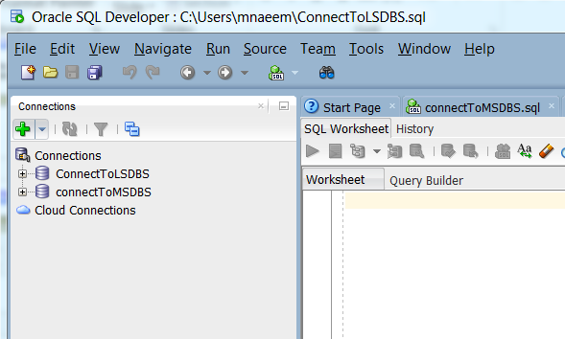
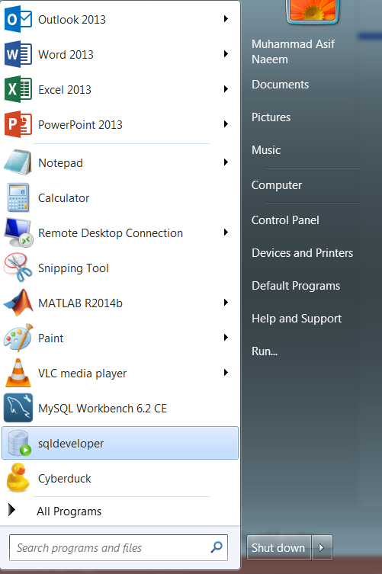
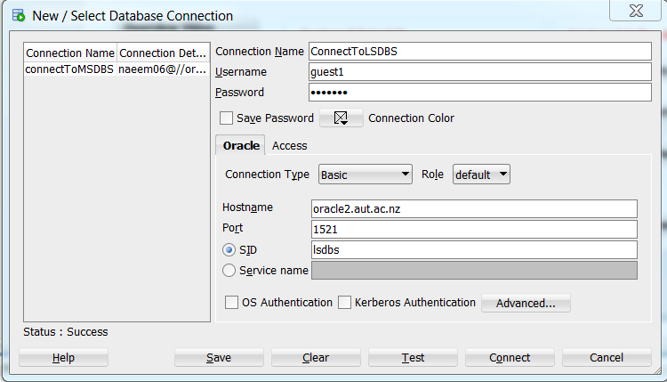
How to access SQL Developer?
Step 2
Step 1
Step 3

Slide 32
Lab Activities
Complete SQL exercise
Using the scripts provided on AUTOnline create the Hotel and HR schemas, using SQL Developer.

